Slide 1
More with kinematics

Slide 2
Using graphs

Slide 3
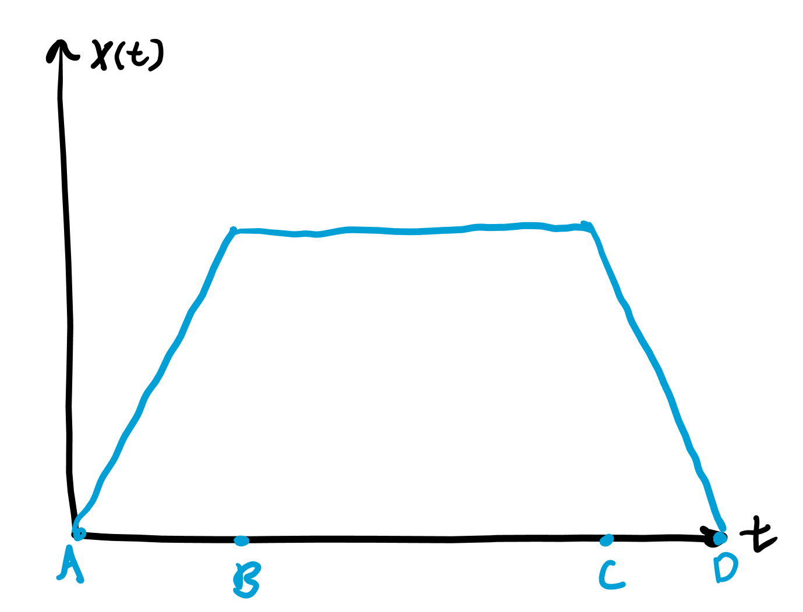
How to interpret position graphs
When position is increasing (A to B), do you think velocity is positive or negative?
What about when position stays the same (B to C)?
When position decreases (C to D)?
Velocity is positive when position is increasing, but negative when it is decreasing. It is zero when position is not changing.

Slide 4
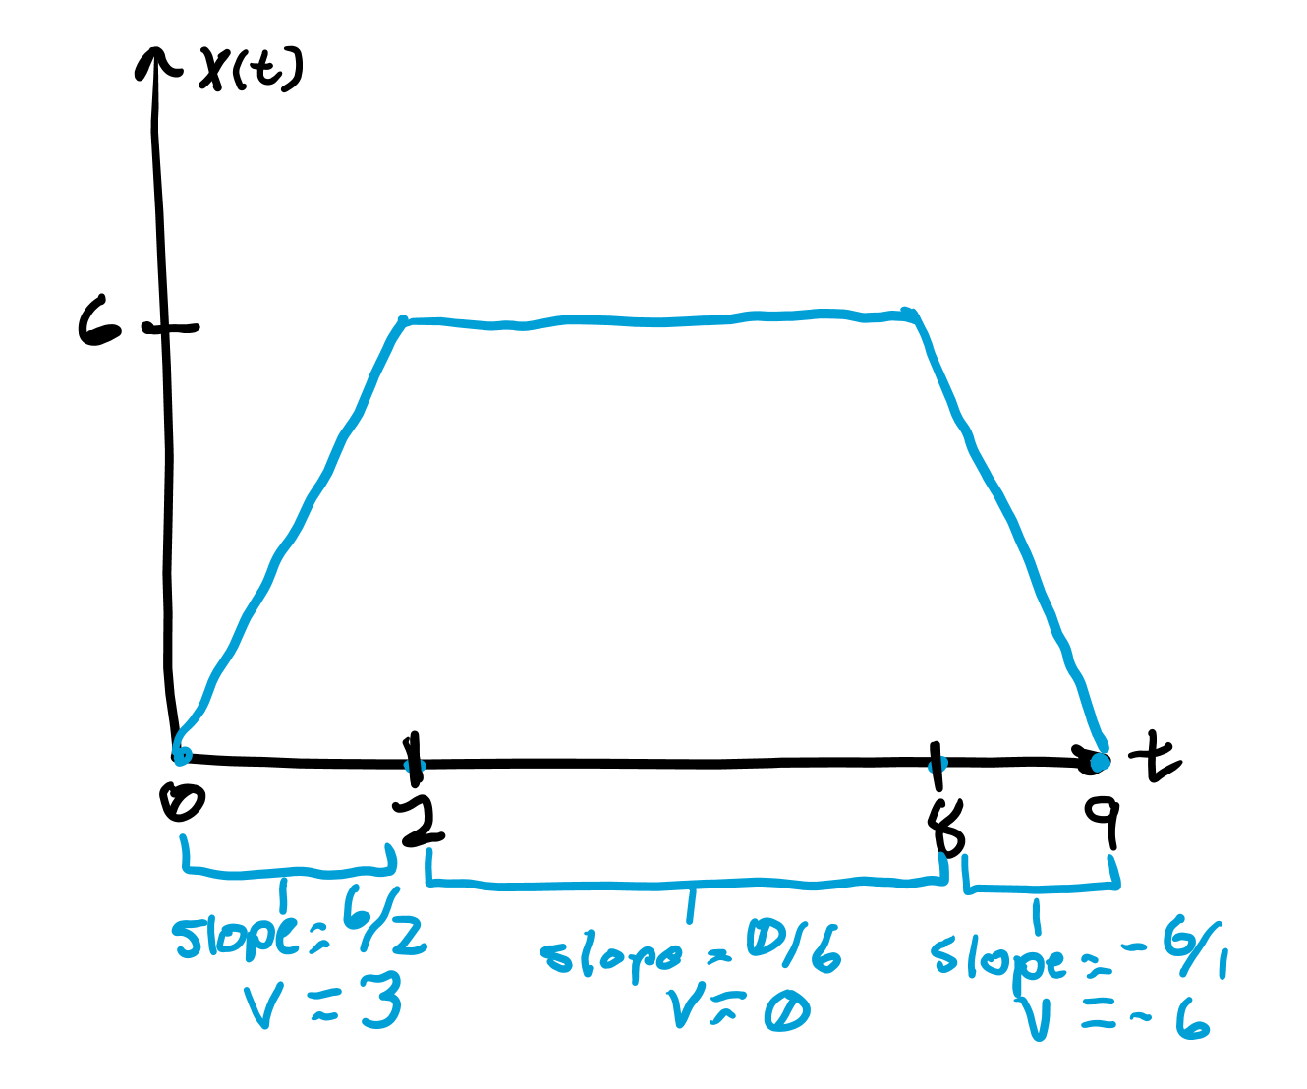
Slope
To find the exact value of the velocity at a certain point of time, all you have to do is take the derivative at that point.
Graphically, this is equivalent to finding the slope of the graph at the point.

Slide 5
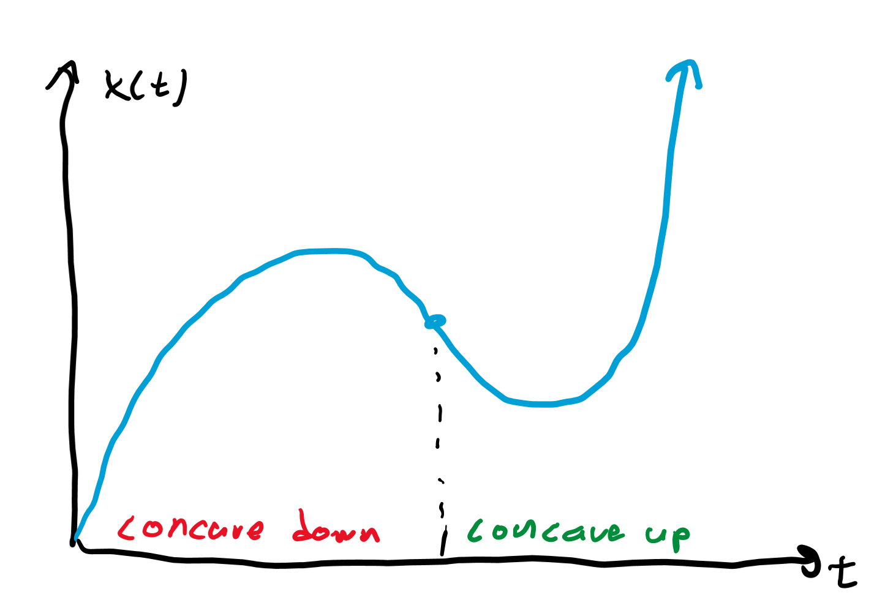
Concavity
What about when position graphs are curved? If they look like part of a smiley face, they are “concave up.”
Straight lines have 0 concavity, meaning acceleration is zero for that position graph.
If they look like part of a frowny face, they are “concave down.”
Concave up like a cup, down like a frown!
Concave up means velocity is slowly increasing, so acceleration is positive. Concave down means acceleration is negative.

Slide 6
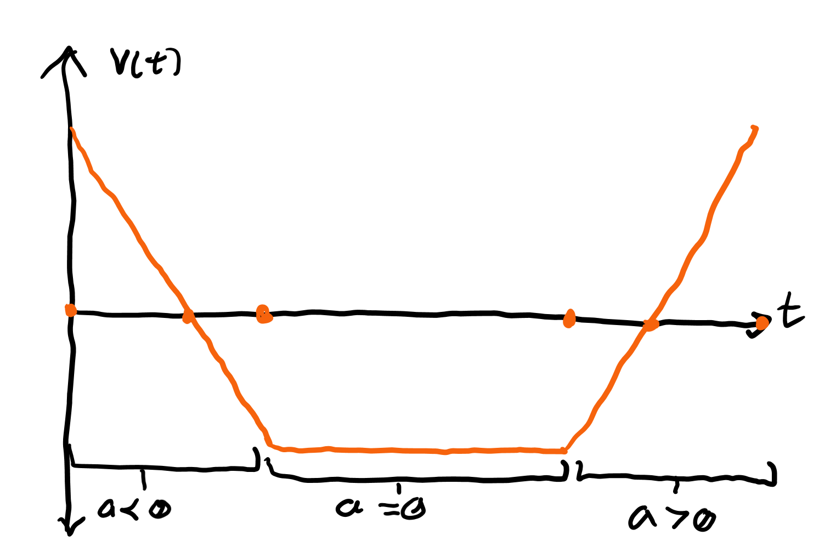
How to interpret velocity graphs
Like position graphs, if velocity is increasing, acceleration is positive.
If velocity is decreasing, acceleration is negative.
If velocity is not changing, there is no acceleration.

Slide 7
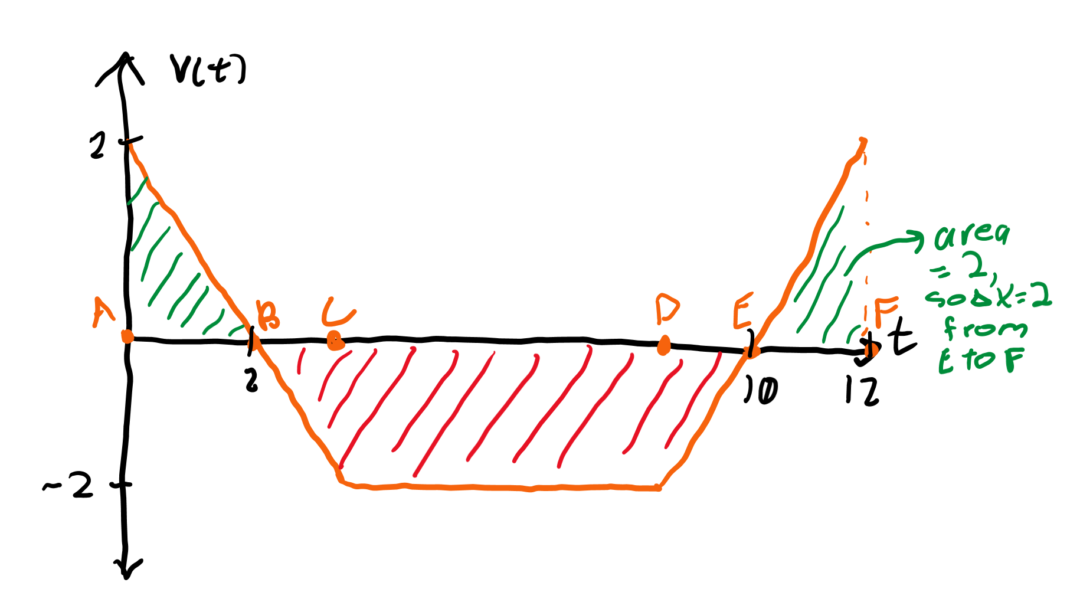
Area under a curve
We can also determine the distance by multiplying velocity by time.
Graphically, the way to do this is to find the area under the velocity-time graph.
The area can be negative like from B to E.
We can also find the distance traveled in a certain time frame, such as from E to F specifically by finding the area under that section specifically.

Slide 8
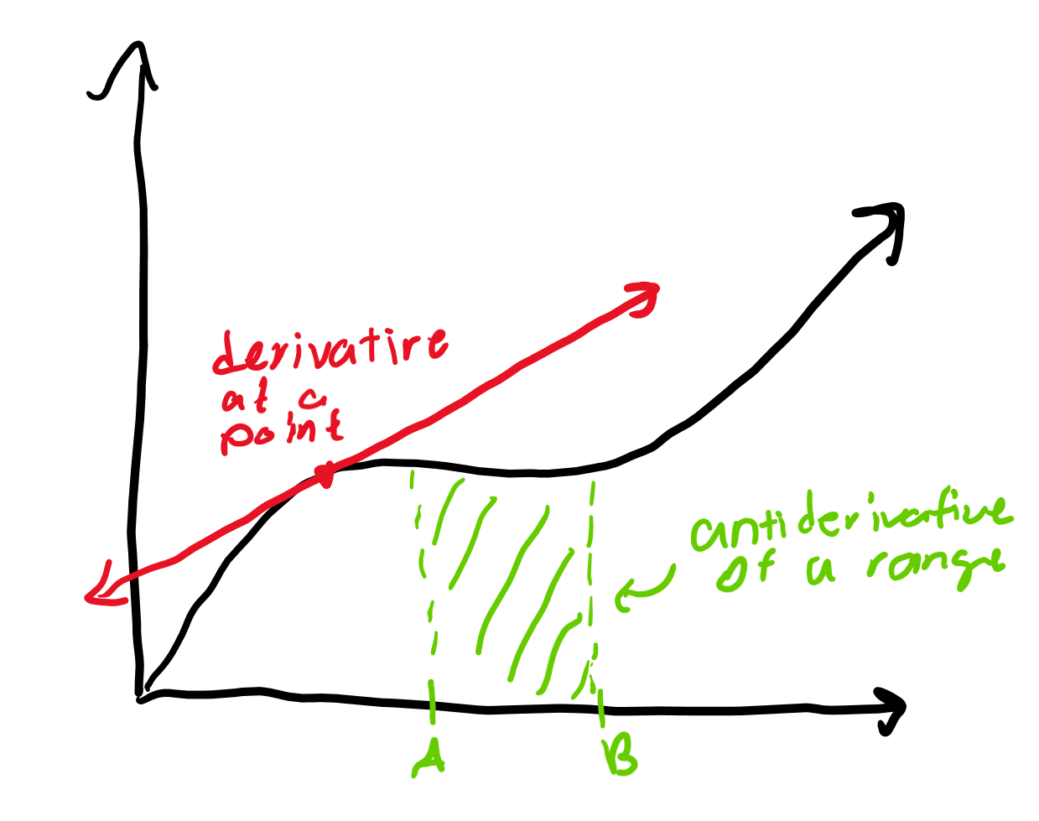
Derivative vs antiderivative
The derivative was finding rise over run. The opposite of dividing rise by run would be multiplying rise by run.
Finding the area under the curve involved us “multiplying” rise and run, so we can call this the “antiderivative.”
So a derivative is finding a slope but an antiderivative is finding an area.
You can take the derivative of a point, but the antiderivative must be of a range.

Slide 9
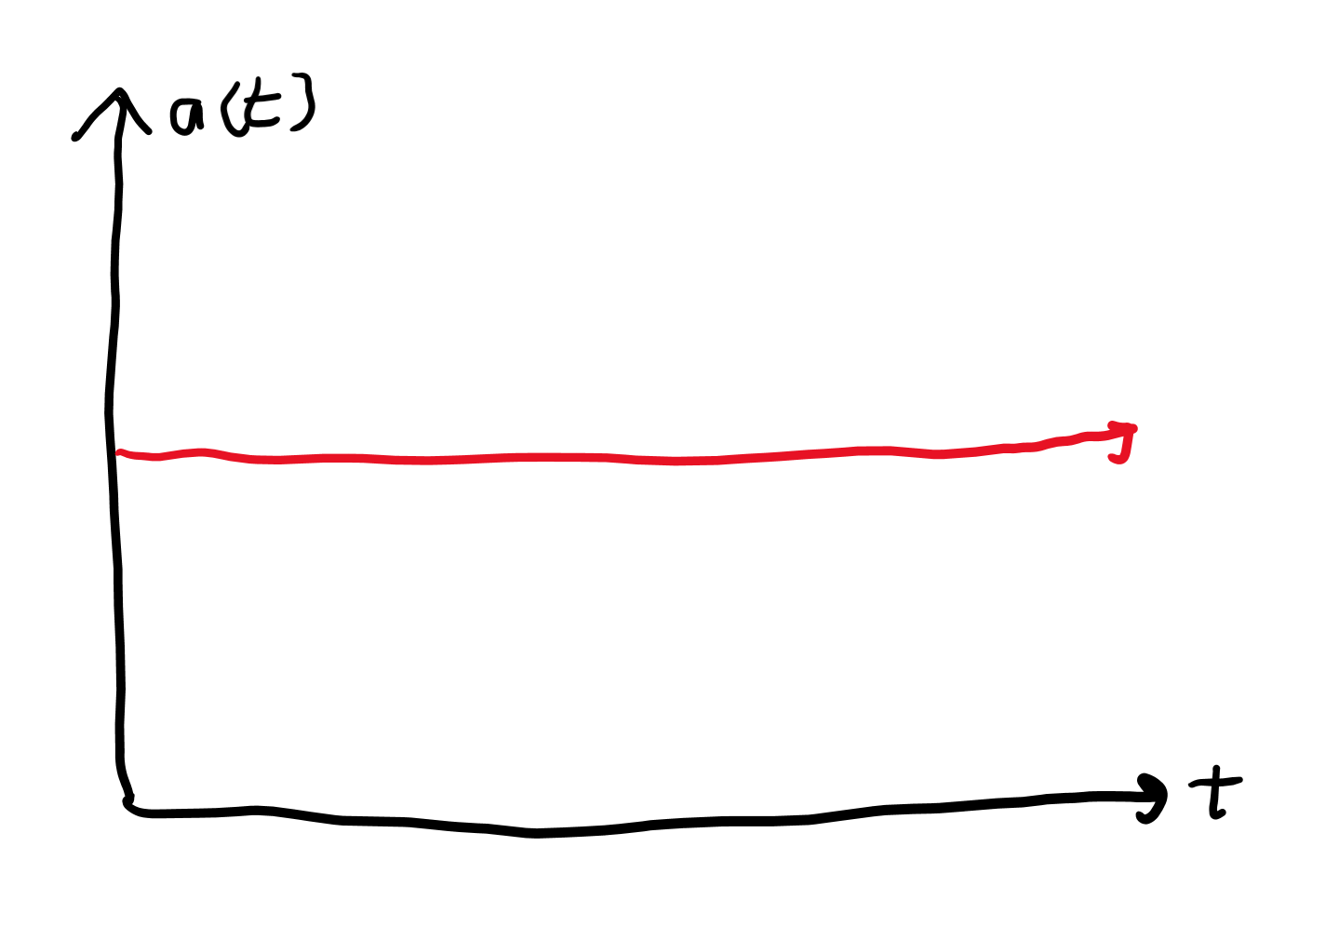
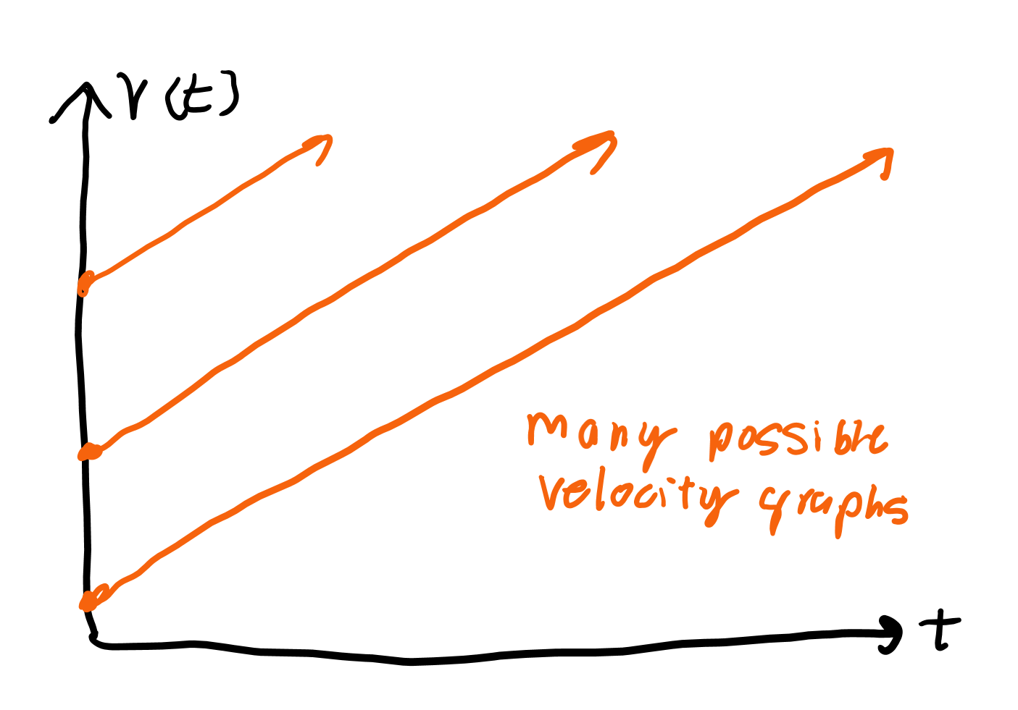
How to interpret acceleration graphs
Acceleration graphs are usually constant. They tell you the slope of the velocity graphs.
However, you do not know the exact velocity of a point unless you know the initial velocity (think back to how there are multiple antiderivatives graphs for each curve, so there are multiple velocity graphs for a single acceleration).

Slide 10
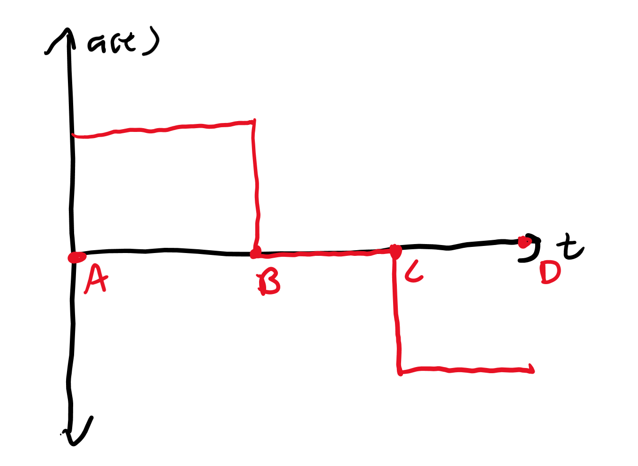
Piecewise functions
We may have the velocity change at different rates at different times.
From A to B, velocity increases. From B to C, velocity does not change. From C to D, velocity decreases.
The area under the curve tells you by exactly how much velocity increases or decreases.

Slide 11
Kinematic equations

Slide 12
Key assumptions and ideas
Acceleration must be a constant value for the kinematic equations to apply
The kinematic equations can be derived with calculus with a constant acceleration
Δ represents change:
Δx = x_{f} - x₀ (aka, the final displacement minus the initial displacement, giving the change in displacement) -- the 0 stands for initial or at time equals zero.

Slide 13
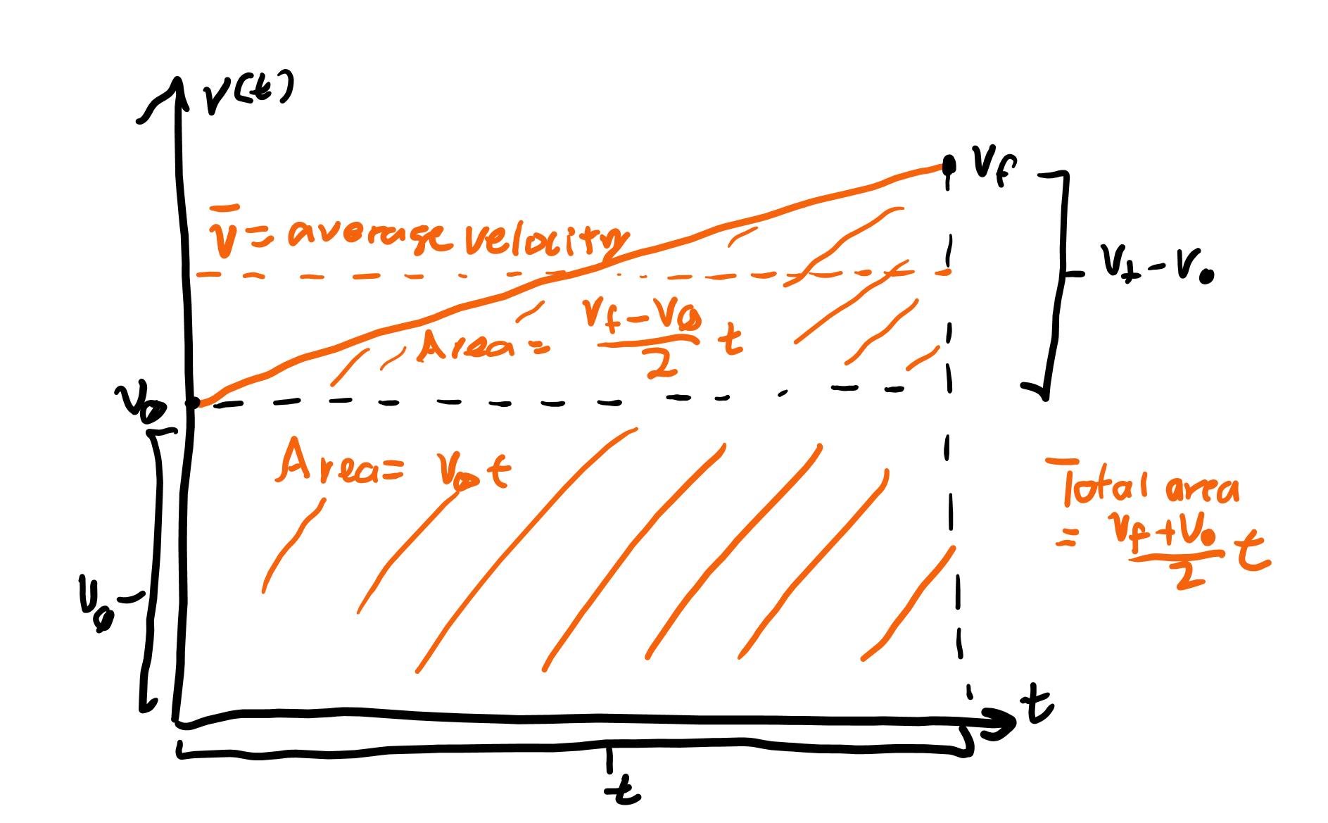
Position-velocity
If acceleration is constant, the graph of velocity is a line.
The average velocity in a given period of time is thus the average of the initial and final velocities.
Multiplying the average velocity by time gives the distance traveled in that amount of time.
Δx = [(v_{f} + v₀)/2] * t

Slide 14
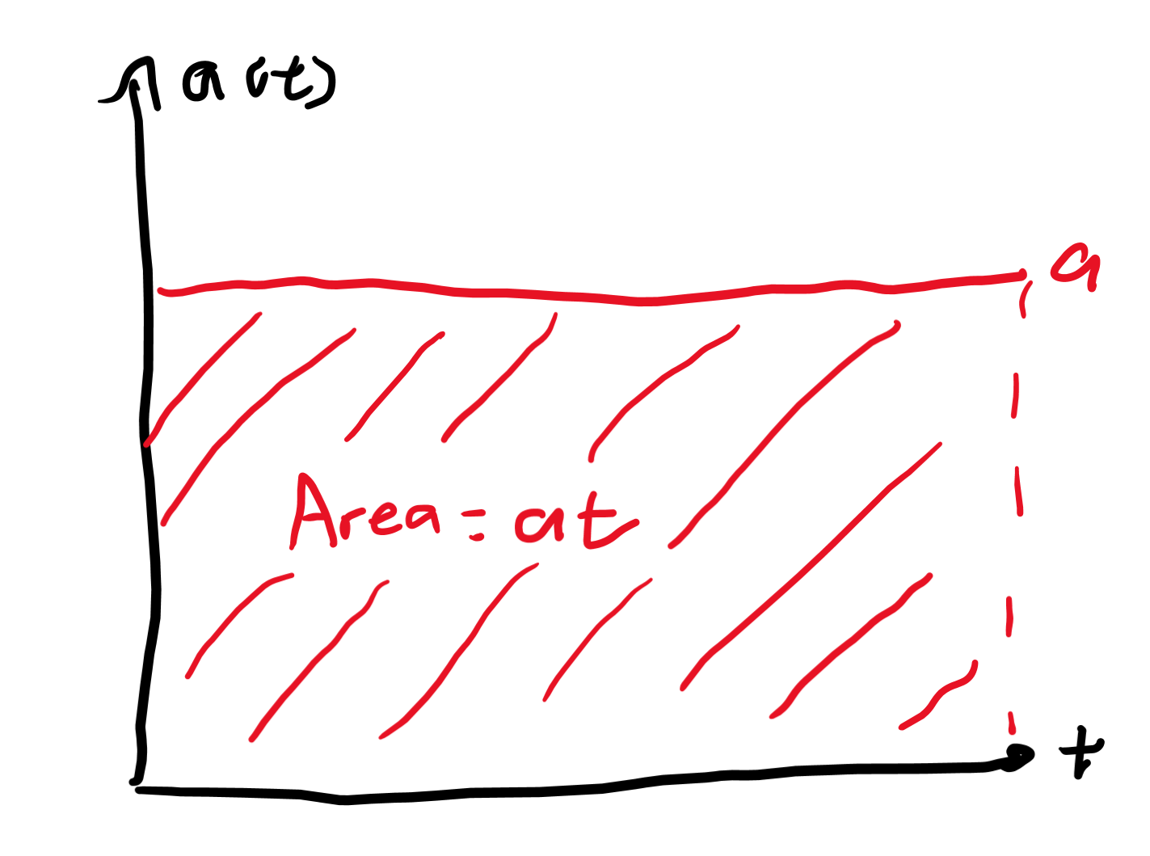
Velocity-acceleration
Acceleration is constant, and multiplying it by time gives the change in velocity.
Δv = at is the second equation.

Slide 15
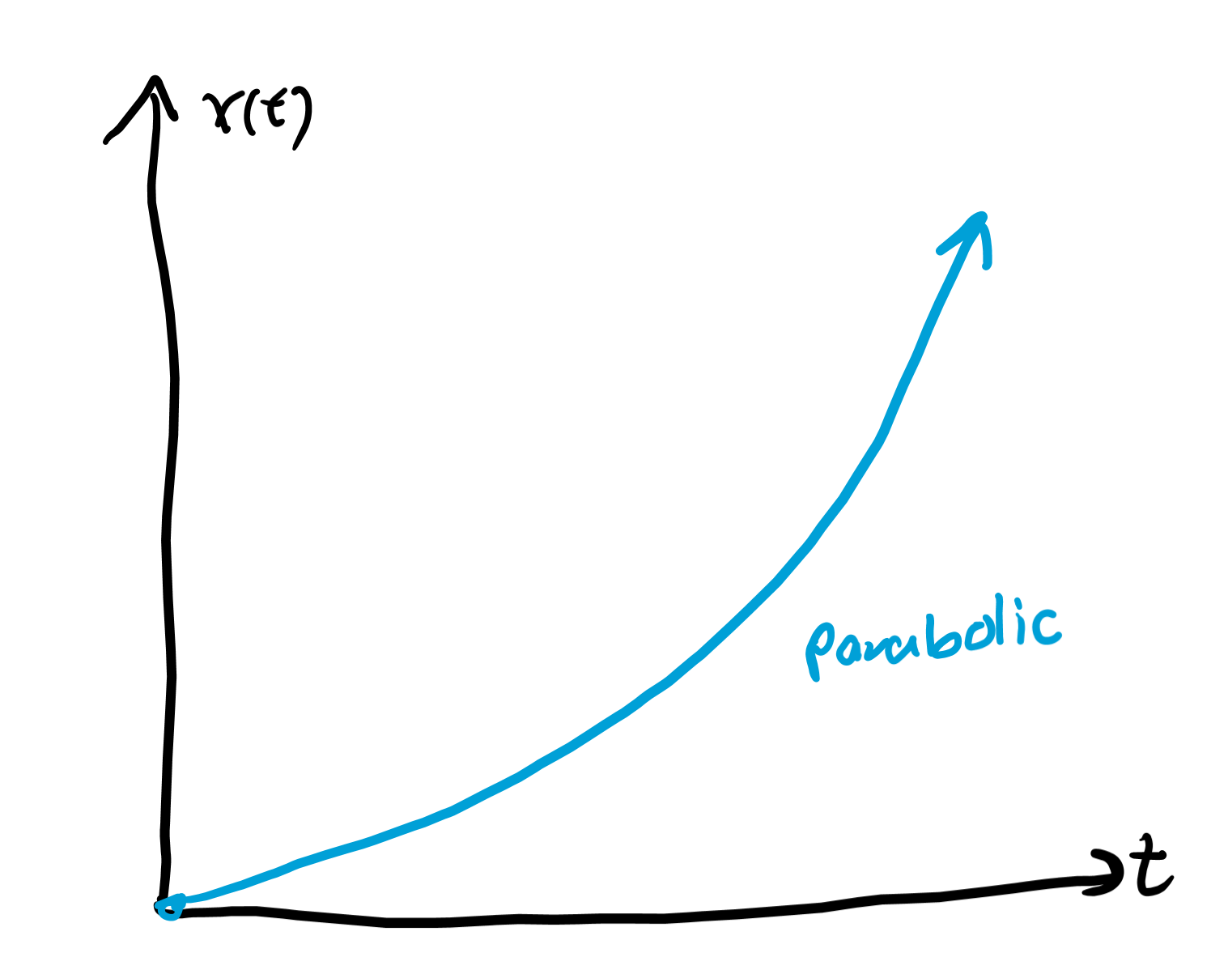
Position-acceleration
Integrating the constant acceleration function a(t) = a gives v(t) = v₀ + at, for a constant v₀ and integrating again gives the function x(t) = x₀ + v₀t + ½ at².
This is the position-acceleration kinematic equation, which is often rearranged to give x_{f} = x₀ + v₀t + ½ at², so Δx = v₀t + ½ at².

Slide 16
Time-not-found
We know Δx = [(v_{f} + v₀)/2] * t, so that means 2Δx = t(v_{f} + v₀).
Now multiply both sides by a to give 2aΔx = at(v_{f} + v₀).
We also know that at = Δv = v_{f} - v₀.
That means 2aΔx = (v_{f} - v₀)(v_{f} + v₀), so 2aΔx = v_{f}² - v₀², and v_{f}² = v₀² + 2aΔx.
As this equation doesn’t involve time, this is called the time not found equation.

Slide 17
Force

Slide 18
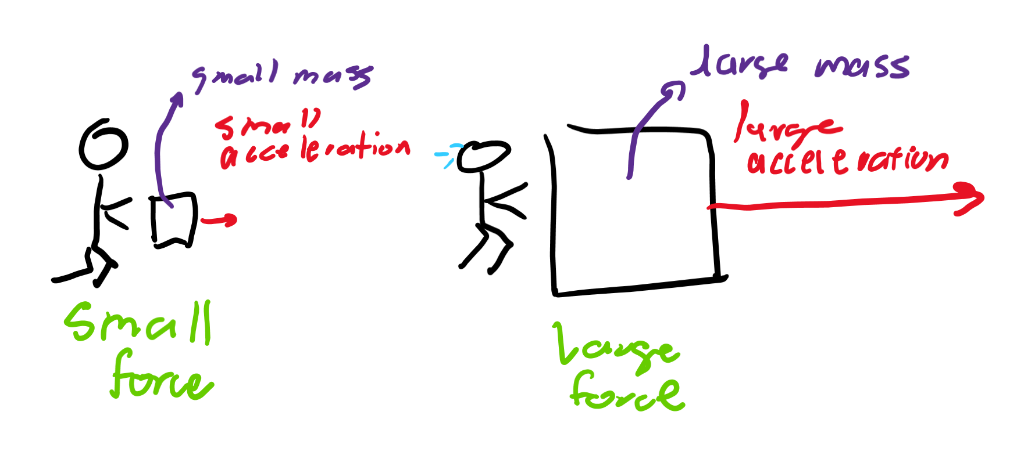
Equation for force
Force is described as how difficult it is to accelerate something.
The more mass an item has, the more force it requires to accelerate.
The more acceleration you apply to an object, the more force it requires too.
Thus, F = m*a, or force = mass * acceleration. Increasing either mass or acceleration in this equation increases force.

Slide 19
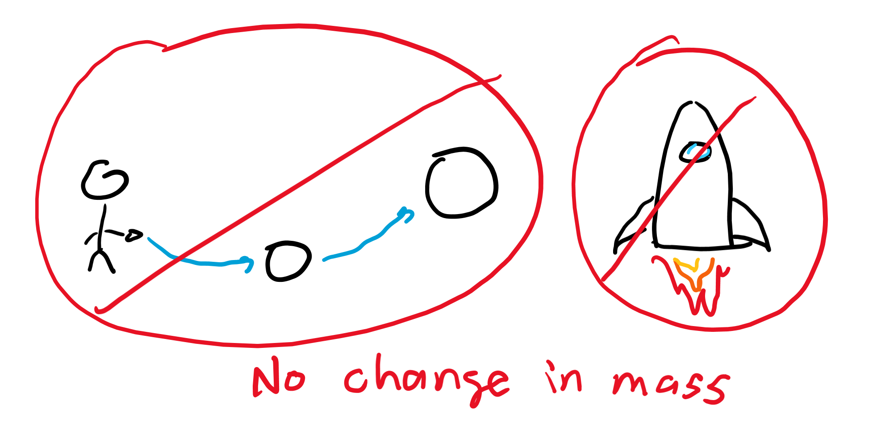
The role of mass
The mass of an object tells you how resistant something is to moving.
However, the mass of an object is unlikely to change. . . unless it’s the mass of fuel in a rocket, but that’s rocket science (which we will cover).

Slide 20
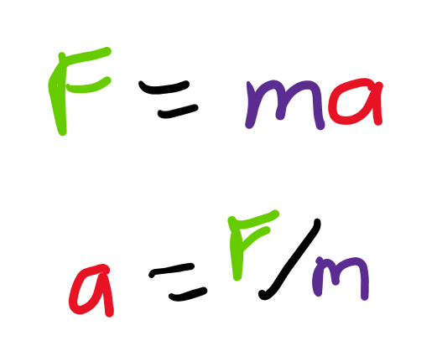
Using force
Thus, what is important about force is that, if we know the mass of an object, we can determine the acceleration applied to that object by dividing force by the mass!
In problems involving force, the mass is generally given so you can use the acceleration to determine things like velocity and displacement.

Slide 21
Units
Mass for physics is measured in kilograms (kg), but in chemistry grams (g) may be more common as you deal with smaller objects.
Force = mass * acceleration, so it has units kg * m/s². This is also called a Newton (N), and is our first derived unit. These units are derived from combining “base” units (of which we’ve covered kg, m, and s).

Slide 22
Free fall

Slide 23
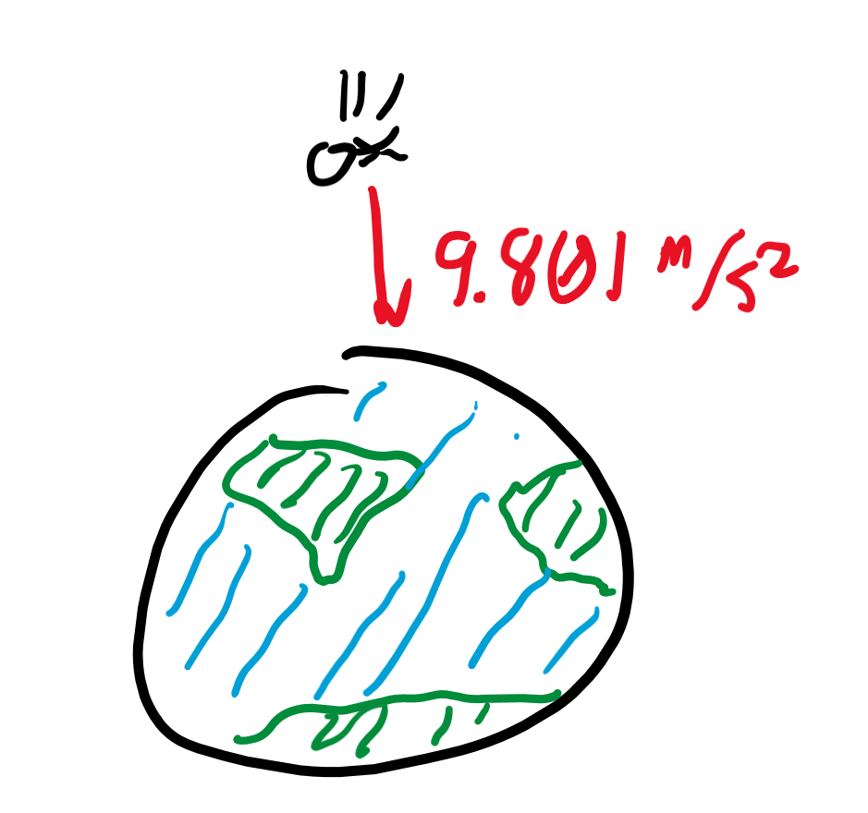
Gravity
Gravity applies a force on every object in a certain direction.
We generally describe that direction as negative (downward), so the force of gravity is a negative force.
Gravity provides a different force on all objects, but it accelerates them all equally at -9.801 m/s².

Slide 24
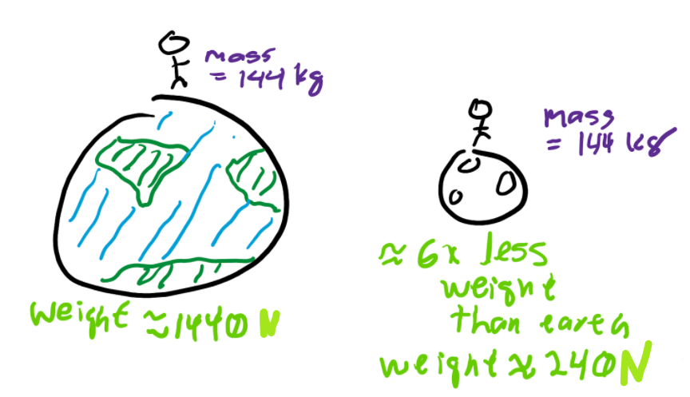
Force of gravity
Multiplying the acceleration due to gravity by the mass of an object tells you the force of gravity applied on an object.
This force is called weight. Notice how mass is used to calculate weight, but they are not the same thing.
Moving a mass to a planet with weaker gravity would result in a weight of smaller magnitude.

Slide 25
Free fall
If acceleration is -9.8 m/s², determine the position function with relation to time ignoring any initial velocity and position.
Hint: take the antiderivative twice but set the constants that arise from the antiderivative to zero.
This function should look like: x(t) = -(4.9 m/s²) t². In general, this is written as Δx = ½ at² (a itself should be negative).

Slide 26
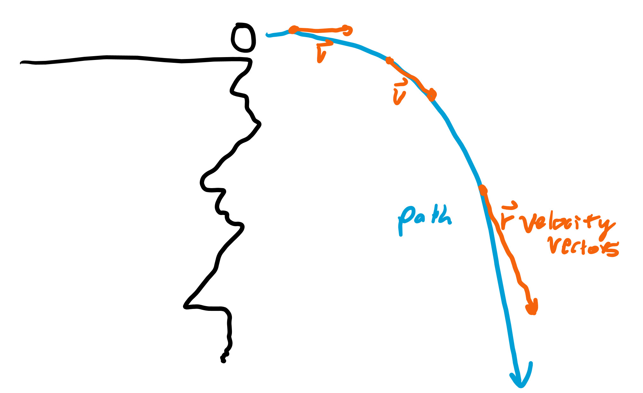
Free fall with horizontal motion
A common problem involves an object that is subjected to free fall that is also pushed parallel to the ground.
No part of the pushing is upward or downward, so the vertical position should still follow the free fall equation assuming still that v₀ is zero.

Slide 27
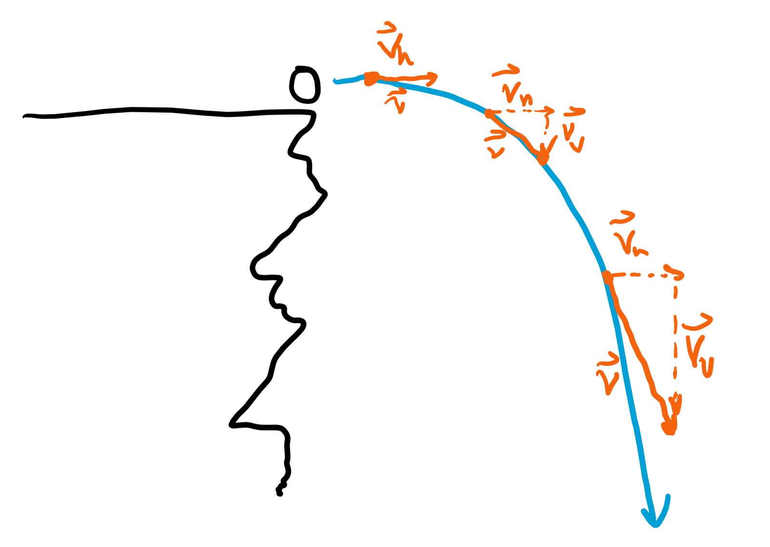
Separating vectors
You can look at “components” of the velocity vectors of a ball falling with horizontal velocity.
The horizontal velocity component is constant, but the vertical velocity component increases in magnitude.

Slide 28
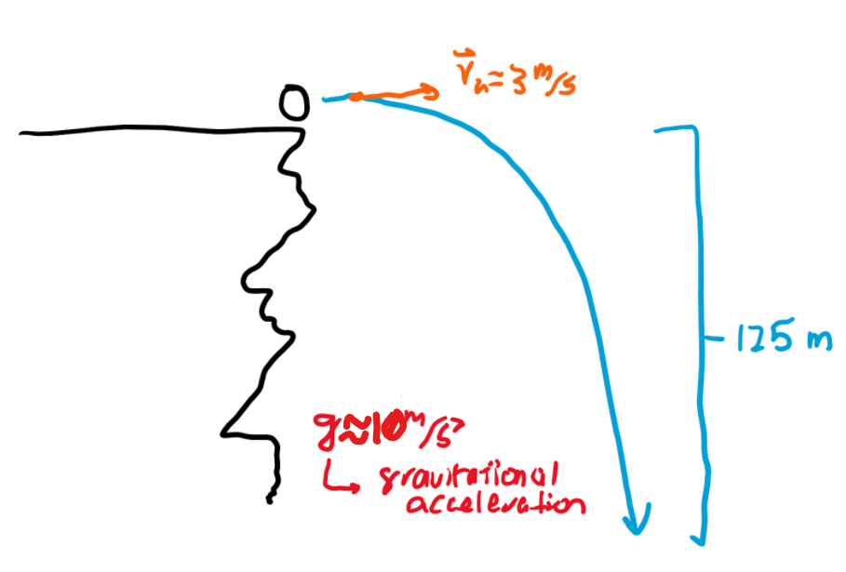
Determining horizontal displacement
As the horizontal component does not change. One can determine how far it travels by multiplying the time it takes for the object to fall to the ground by the horizontal component of velocity.
The time can be determined if you know the height fallen (Δx) and the gravitational acceleration (probably 9.8 m/s²) using the Δx = ½ at² equation.

